Slide 1


Surface-Modified Cellulose Sponges for PFAS Removal: A Rapid Small Scale Column Test and Isotherm Study
Kayla Courtright
University of Arizona – KORES Lab – Dr. Vasiliki Karanikola
NASA Space Grant Consortium Statewide Student Research Symposium
ASU Scottsdale Innovation Center -April 18, 2026

Slide 2

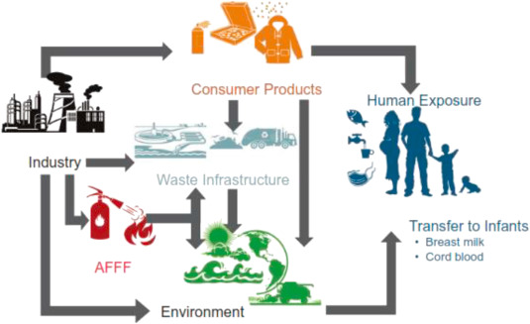
Introduction
Poly- and perfluorinated substances (PFAS) are a category of human-made chemicals that are resistant to degradation and bioaccumulate in ecosystems and organisms, causing significant risks to health.
Current treatment methods like reverse osmosis and ion exchange resins are costly and require frequent regeneration. Granulated activated carbon (GAC) treatment is limited to being single use due to its economically unviable regeneration process.
1
Olatunde, O. C., Kuvarega, A. T., & Onwudiwe, D. C. (2020). Photo enhanced degradation of polyfluoroalkyl and perfluoroalkyl substances. Heliyon, 6(12), e05614. https://doi.org/10.1016/j.heliyon.2020.e05614

Slide 3
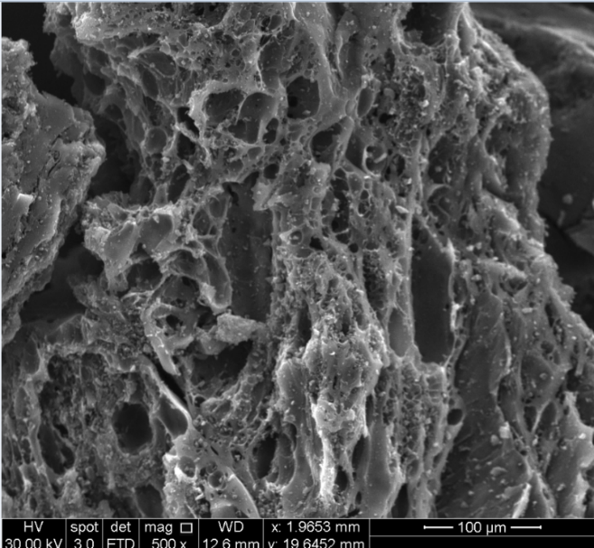
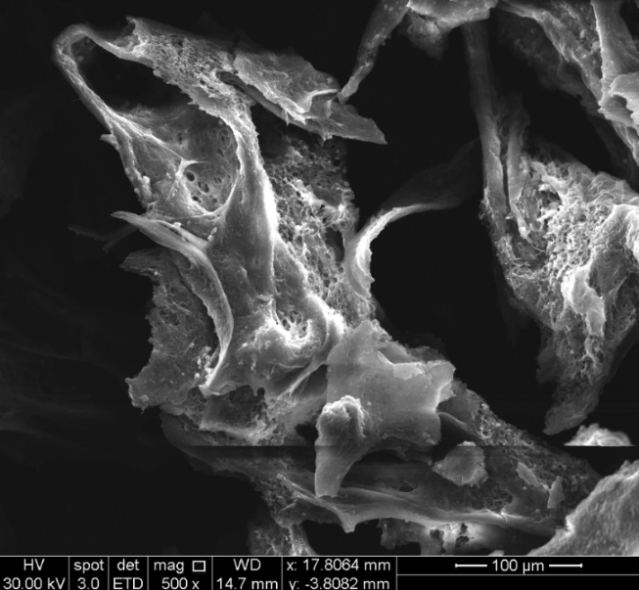
Cellulose Sponges
GAC’s adsorption capabilities come from its highly porous structure (micro- and mesopores). (Figure 1A)
Modified cellulose sponge sorbents have been also studied because they have similar pore structures (macro- and micropores) (Figure 1B).
  Cellulose Sponges could be a potentially reusable, low-cost, and environmentally alternative to GAC
a)
b)
Figure 1: SEM images at 500x of a) GAC and b) cellulose sponge
2

Slide 4
Surface Modifications
Selected modifications: 3-Aminopropyltriethoxysilane (APTES), Triethoxy(octyl)silane (C8),Trimethoxy(octadecyl)silane (C18), and hydroxyl group (activated). (Figure 2)
C8 and C18 are long carbon chains that adsorb PFAS through hydrophobic interactions while APTES and activated modifications have polar end groups with electrostatic or hydrogen bonding for adsorption
Figure 2: (left) Surface modifications and (right) silanization mechanism of cellulose sponges.
3

Slide 5


Rapid Small Scale Column Test (RSSCT)
RSSCT systems are designed to emulate the performance of larger scale water treatment systems at a fraction of the size while using significantly less influent water and sorbent media. (Equations 1 and 2)
Equation 1: RSSCT Scaling Equation. Sc denotes small scale. LC denotes large/pilot scale. Empty Bed Contact Time (EBCT) is the total bed volume divided by flow rate, radius of the sorbent (R), and the time for the time to conduct and RSSCT experiment (t)
Equation 2: RSSCT Scaling Equation. Bed Volume (V). The ratio of bed volumes is equal to the ratio of particle radii between sizes.
4
Crittenden, J. C., Berrigan, J. K., & Hand, D. W. (1986). Design of Rapid Small-Scale Adsorption Tests for a Constant Diffusivity. Journal (Water Pollution Control Federation), 58(4), 312–319. http://www.jstor.org/stable/25042907

Slide 6
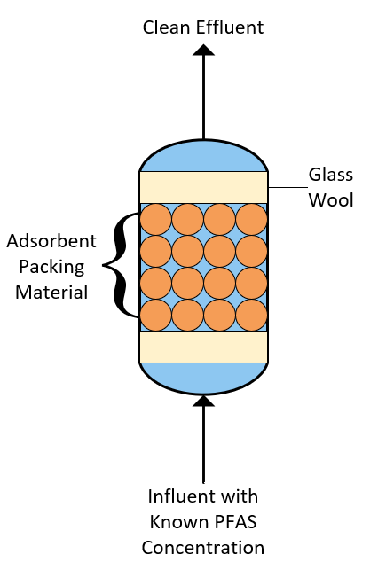
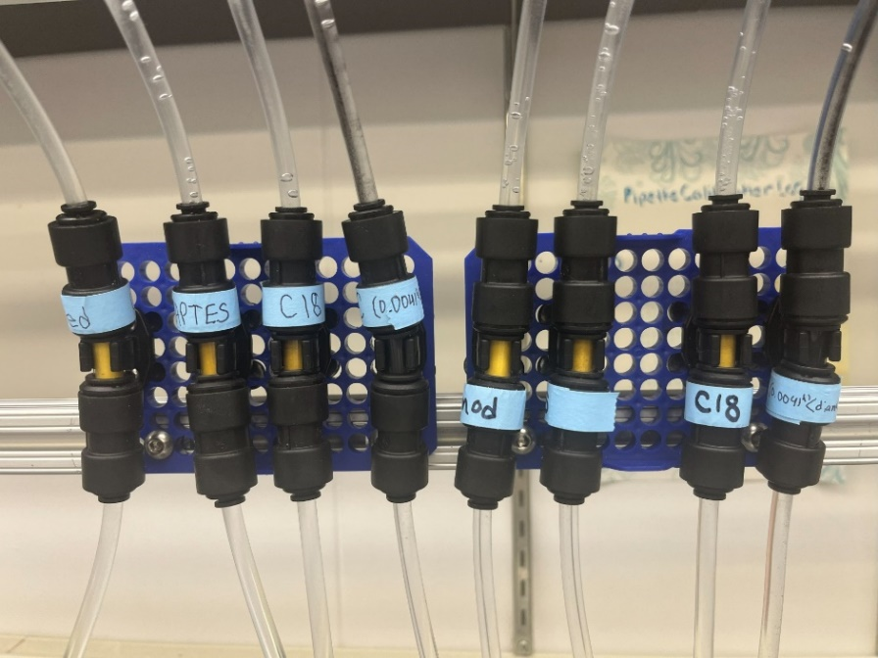
Columns
Water with PFAS is pumped through the columns containing the modified sponges and the outlet water is sampled during experiments. (Figure 3)
Figure 3: RSSCT Column Design
4

Slide 7
Break Through Curves
The experimental samples analyzed by liquid chromatography with tandem mass spectrometry (LCMS).
  The data were plotted as concentration vs # of bed volumes to create breakthrough curves to see when the sponges stop adsorbing PFAS.
  This shows if there is constant or non-constant diffusivity and which adsorption properties are dominant.
Figure 4: (left) Breakthrough curves of unground sorbents with particle diameter of ~1-3mm and (right) ground sorbents sieved to a particle diameter of 335 microns.
5

Slide 8
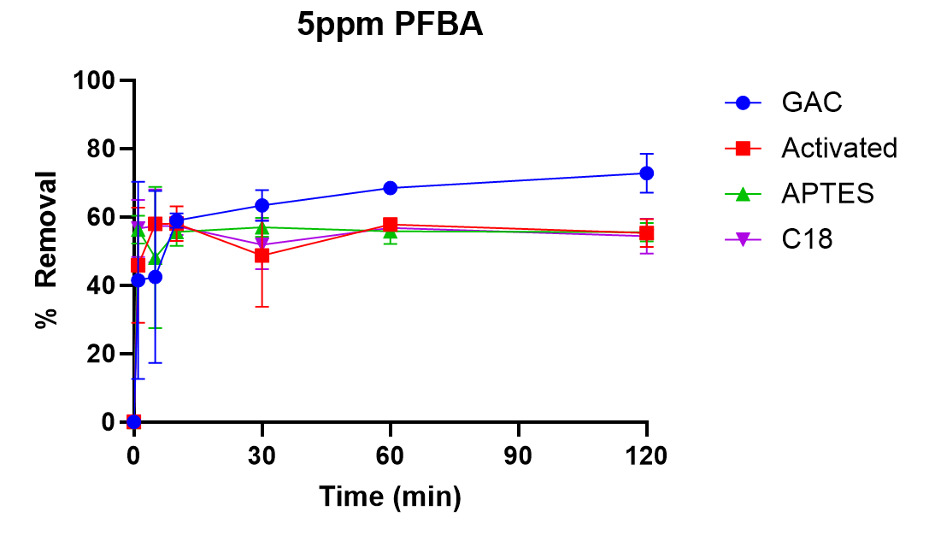
Isotherm Study
Adsorption isotherms were conducted to determine:
  the maximum equilibrium adsorption capacity (Qmax) of each modified sorbent
  whether PFAS adsorption is physisorption (surface interactions) or chemisorption (chemical bond formation)
Method: 50 mg of sorbent submerged in 50 mL of a known concentration of PFAS and taking time dependent samples over a two-hour period.
  Samples were analyzed with LCMS to create adsorption curves, used to determine the maximum equilibrium sorption capacity of the sorbents
Figure 5: The adsorption curve of the different sorbents for 5 ppm PFBA
6

Slide 9
Conclusion
RSSCTs and adsorption isotherm testing is ongoing.
Current results do not show conclusive breakthrough.
  The sorbents can absorb more PFAS before they are rendered ineffective.
  Longer term experimental runs are needed to find when the continuous operation maximum adsorption capacity is achieved.
Further RSSCT experiments will need to be conducted in the future.
Preliminary results suggest that surface-modified cellulose sponges could be a competitive alternative to GAC.
7

Slide 10
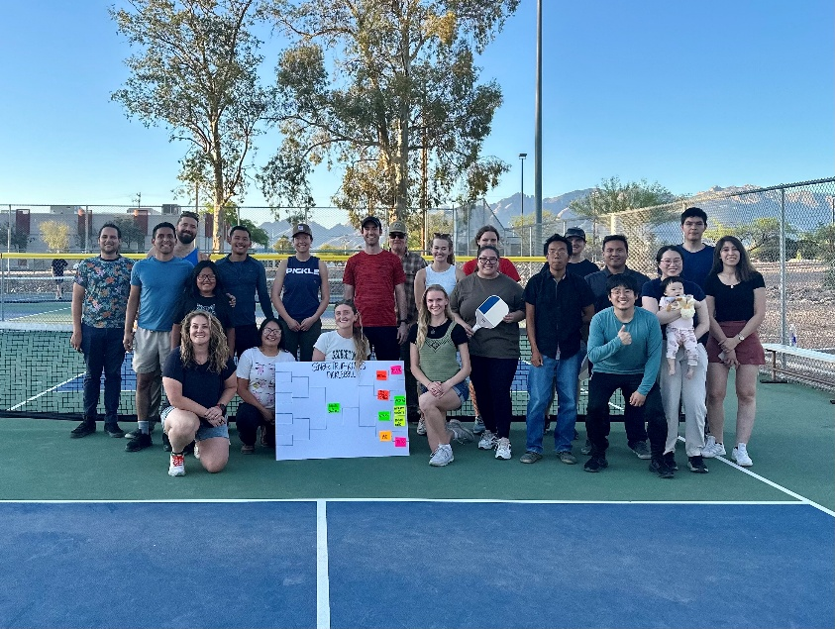

Acknowledgements
Thank you to Dr. Vasiliki Karanikola, Dr. Jack Welchert, and the entirety of KORES Laboratory. Supported in part through the Arizona NASA Space Grant Consortium, Cooperative Agreement 80NSSC25M7084.
https://koreslab.com/
8

Slide 11
Thank you!

